Slide 1
Enhancing LLM based Recommendation System using Vision Models
By: Dustin Yan

Slide 2
Problem Statement
Can we utilize a Vision Model to analyze image data, thus further improving personalized recommendations generated by a LLM?

Slide 3
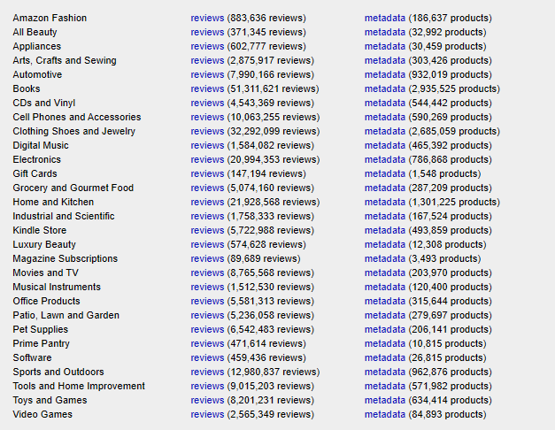
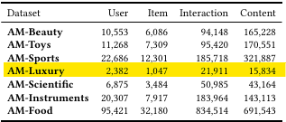
Dataset
Amazon 2018 review data

Slide 4
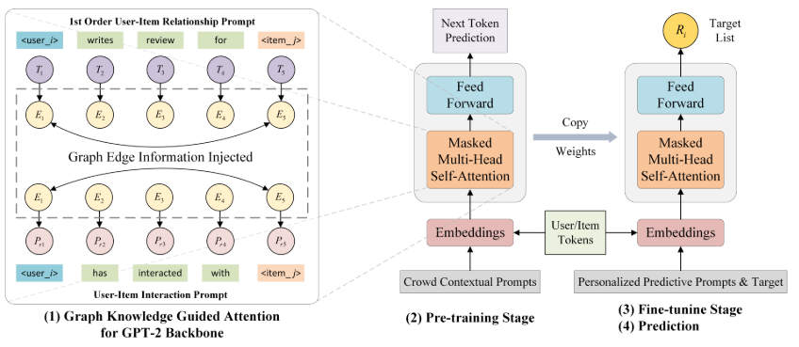
Baseline - Solution

Slide 5
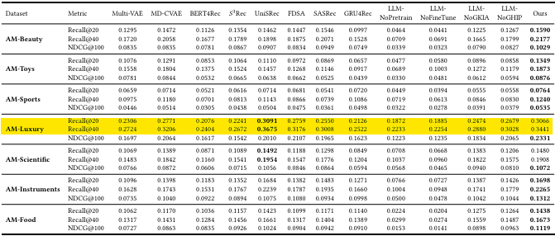
Baseline - Results

Slide 6

Baseline - Discrepancies
Using less epochs, less training time
Less computing power

Slide 7
New Approach
Can we enhance an already good generative LLM that recommends items?
Add Vision Model to analyze item’s images
Yolov8

Slide 8
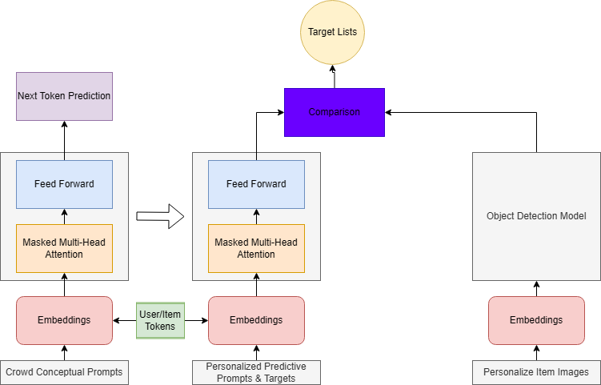
Architecture Diagram

Slide 9
Implementation of New Approach
Requires changing library code
Hard to incorporate Vision model and LLM to work together.

Slide 10
Insight of a finished implementation
Increased Recall@k if we can utilize both text and image data
Possibility of removing relative recommendations
Vision Model removes some objects that might be personalized
Overall increased performance on personalized recommendations

Slide 11
[1] Xinyuan Wang, Liang Wu, Liangjie Hong, Hao Liu, Yanjie Fu, 2024, LLM-Enhanced User-Item Interactions: Leveraging Edge Information for Optimized Recommendations. https://arxiv.org/pdf/2402.09617
[2] Jianmo Ni, 2018, Amazon Review Data https://nijianmo.github.io/amazon/index.html
[3] LLM4Rec https://github.com/anord-wang/LLM4REC
[4] G. Jocher, A. Chaurasia, and J. Qiu, “YOLOv8 by Ultralytics,” GitHub, Jan. 01, 2023. https://github.com/ultralytics/ultralytics

